Slide 1
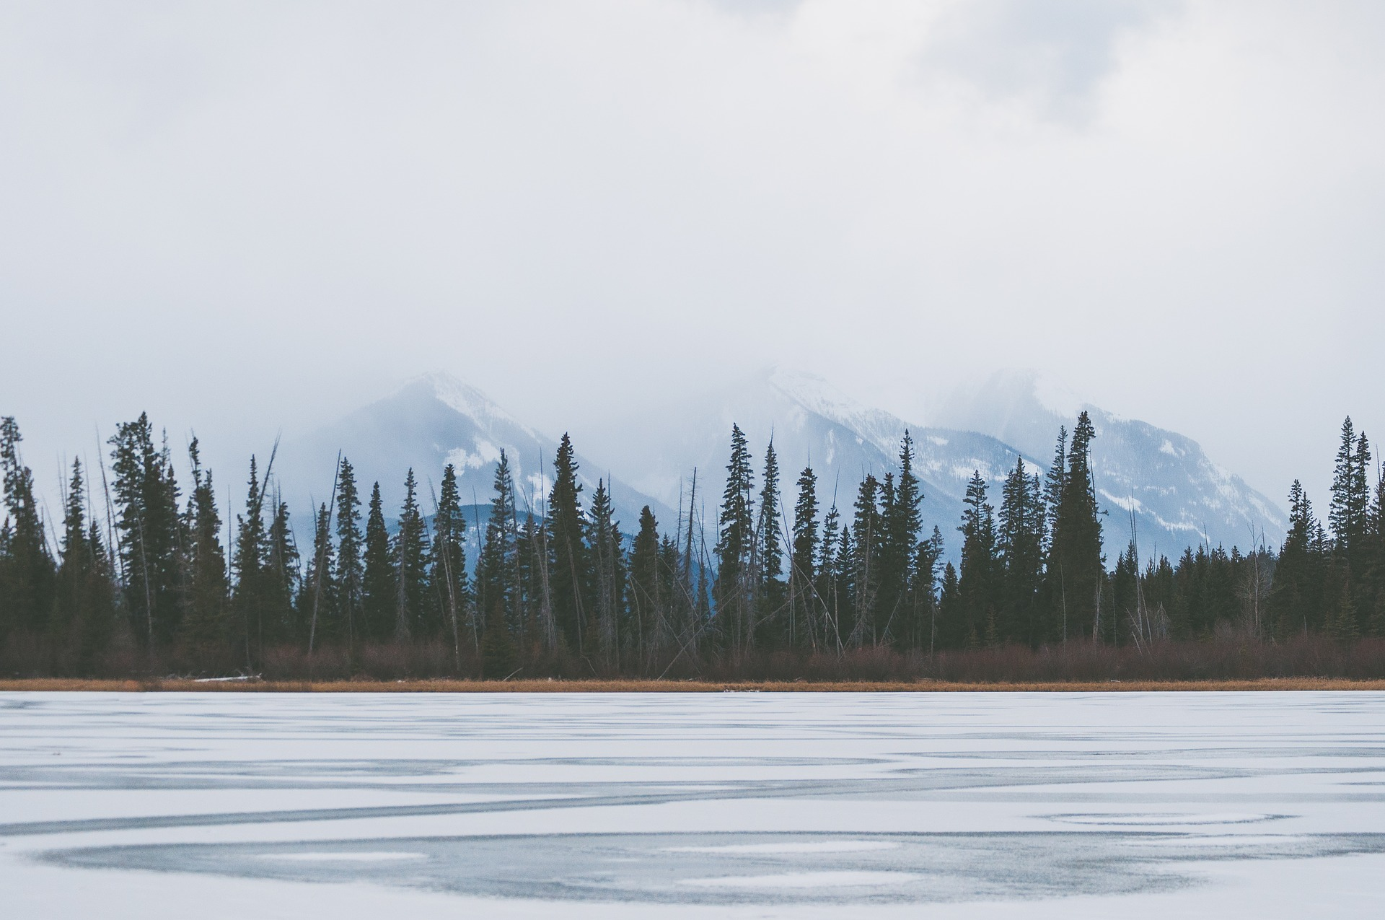
Understanding Wikipedia with
Latent Semantic Analysis
大规模分布式系统
14级大数据 杭圣烨 马一清 周之烁

Slide 2
CONTENTS
01
02
算法
现有成果
03
04
前端效果
未来展望

Slide 3
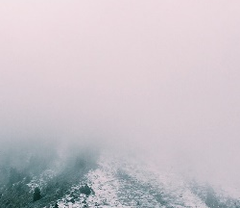
1.1 PART
TF-IDF ALGORITHM

Slide 4

1PART
TF-IDF
（term frequency–inverse document frequency）
TF-IDF是一种在文本挖掘中广泛使用的特征向量化方法，它可以评估一个字词对于一个文件集或一个语料库中的其中一份文件的重要程度。
主要思想：如果某个词或短语在一篇文章中出现的频率高，并且在其他文章中很少出现，则认为此词具有很好的类别区分能力，重要性强。
因此，字词的重要性随着它在文件中出现的次数（词频）成正比增加，但同时会随着它在语料库中出现的频率（文件频率）成反比下降。
TF-IDF加权的各种形式常被搜寻引擎应用，作为文件与用户查询之间相关程度的度量或评级。

Slide 5

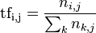
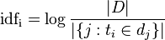
1PART
TF-IDF
词频 (term frequency, TF) 指的是一个词语在某个文件中出现的次数。这个数字通常会被归一化，以防止文件长短不同带来的影响。
逆向文件频率 (inverse document frequency, IDF) 是一个词语普遍重要性的度量。某一特定词语的IDF，可以由总文件数目除以包含该词语的文件数(一般会再加1)，再将得到的商取对数得到。

Slide 6





1PART
For example
《复旦大学成立大数据学院和大数据研究院》
 | TF | IDF | TF-IDF
复旦 | 0.026 | 2.43 | 0.0632
大数据 | 0.060 | 2.18 | 0.1308
学院 | 0.028 | 1.30 | 0.0364
文章长度：1000词
“复旦”：26次
“大数据”：60次
“学院”：28次
“的”：100亿个
“复旦”：0.37亿个
“大数据”：0.65亿个
“学院”：5.02亿个

Slide 7
1.2 PART
SVD ALGORITHM

Slide 8

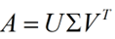
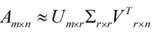



1PART
SVD
(singular value decomposition)
一种适用于任意矩阵的分解方法
适用性
奇异值分解
部分奇异值分解

Slide 9
1PART
m: the number of documents
n: the number of terms
r: the number of concepts
A: term-document matrix
Σ: diagonal matrix
entries the strength of the concepts
U: the relevance of the documents
to the concept
V: the relevance of the term to the
concept

Slide 10





1PART
Term-Term
normalized VΣ
Relevance
Document-Document
normalized UΣ
LSA packs the important information into a lower-dimensional representation that can be operated on instead of the original term-document matrix,
and provides the ability to base the scores on a deeper understanding of the corpus.
Term-Document
u∑v

Slide 11

2 PART
现有成果

Slide 12
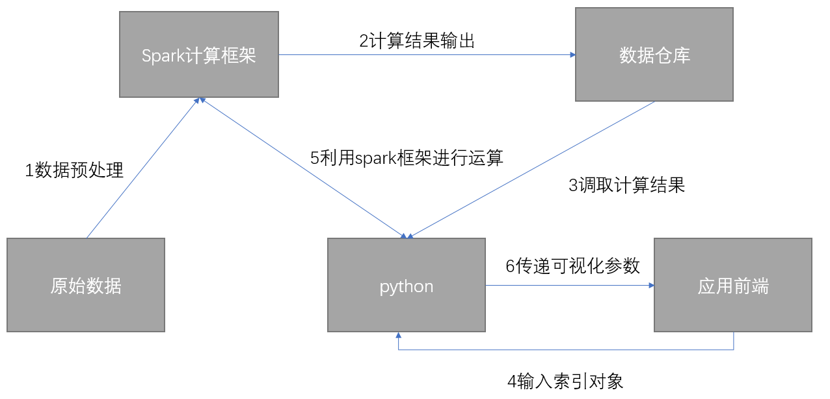
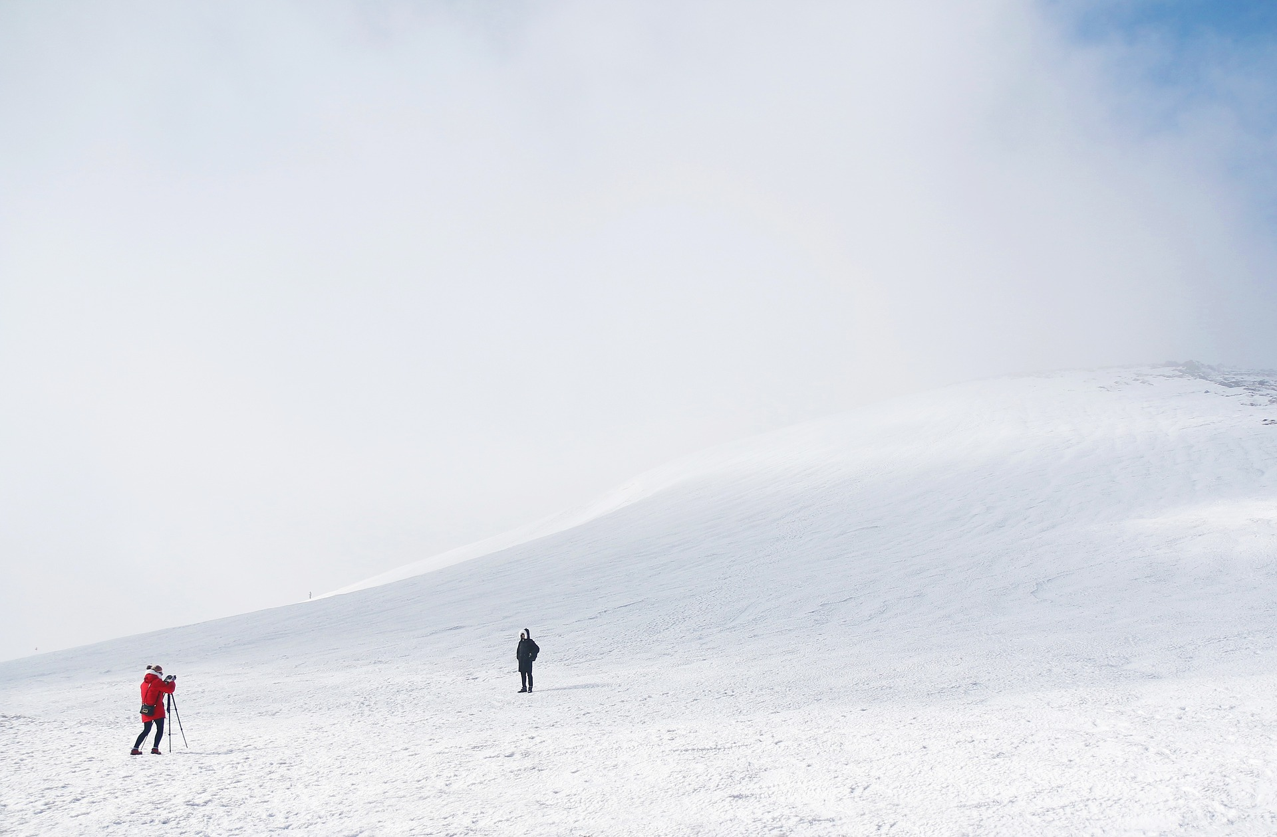
2PART
索引架构图

Slide 13
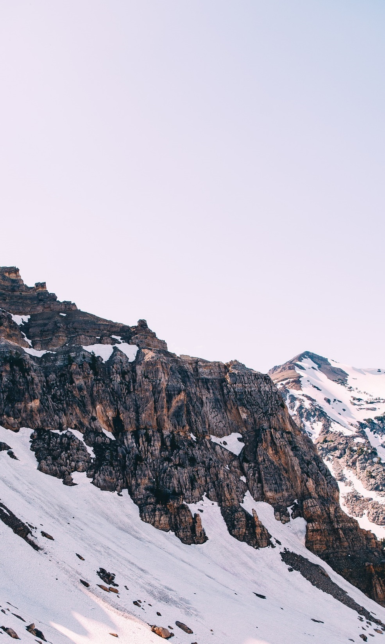
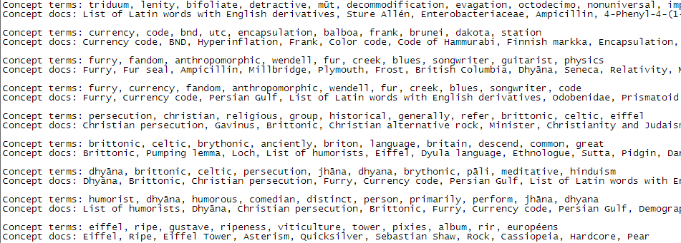
2PART
工作进度
Concepts

Slide 14
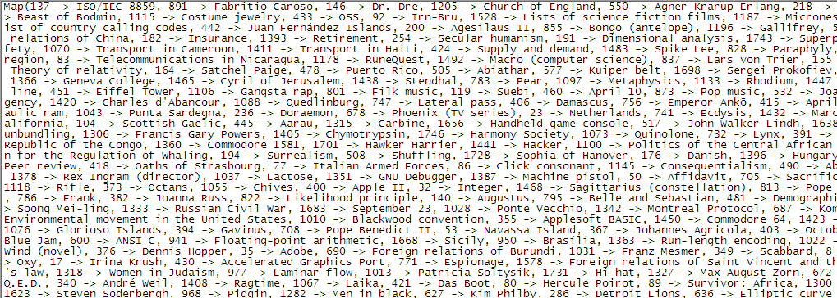
2PART
工作进度
Doc-ids

Slide 15
3 PART
前端效果

Slide 16
3PART
Visualization.1
可视化界面
pag1
pag2
pag3
(algorithm,1.000000000000002),
(heuristic,0.8773199836391916),
(compute,0.8561015487853708), (constraint,0.8370707630657652),
(optimization,0.8331940333186296), (complexity,0.823738607119692),
(algorithmic,0.8227315888559854), (iterative,0.822364922633442),
“Algorithm”
1.Search for the relevant term
Please input document
2.Search for the relevant documents
3.Search for the relevant concept

Slide 17
3PART
Visualization.1
可视化界面
pag1
pag2
pag3
(Romania,0.9999999999999994),
(Roma in Romania,0.9229332158078395),
(Kingdom of Romania,0.9176138537751187),
(Anti-Romanian discrimination,0.9131983116426412),
(Timeline of Romanian history,0.9124093989500675),
(Romania and the euro,0.9123191881625798),
(History of Romania,0.9095848558045102),
(Romania–United States relations,0.9016913779787574),
Please input term
1.Search for the relevant term
“Romania"
2.Search for the relevant documents
3.Search for the relevant concept

Slide 18
3PART
Visualization.1
可视化界面
pag1
pag2
pag3
Concept terms:
summary, licensing, fur, logo, album, cover, rationale, gif, use, fair
Concept docs:
File:Gladys-in-grammarland-cover-1897.png,
File:Gladys-in-grammarland-cover-2010.png, File:1942ukrpoljudeakt4.jpg,
File:Baghdad-texas.jpg
File:DuplicateBoy.jpg
File:RizalHighSchoollogo.jpg
Please input term
1.Search for the relevant term
Please input document
2.Search for the relevant documents
3.Return the important concept & term

Slide 19
3PART
Visualization.1
可视化界面
pag1
pag2
pag3
Concept terms:
summary, licensing, fur, logo, album, cover, rationale, gif, use, fair
Concept docs:
File:Gladys-in-grammarland-cover-1897.png,
File:Gladys-in-grammarland-cover-2010.png, File:1942ukrpoljudeakt4.jpg,
File:Baghdad-texas.jpg
File:DuplicateBoy.jpg
File:RizalHighSchoollogo.jpg
Please input term
1.Search for the relevant term
Please input document
2.Search for the relevant documents
3.Return the important concept & term

Slide 20
3PART
Visualization.1
可视化界面
Albedo
Albedo
Breif introduction
Understanding:
is a measure for [reflectance] or optical brightness ([[Latin]] ‘’albedo,‘’ [[Arabic]] ‘’albayad,‘’ “whiteness”). It is [[Dimensionless number|dimensionless]] and measured on a scale from zero to one.
Relevance:
==Illumination===
===Insolation effects ===
===Climate and weather===
===Albedo–temperature feedback===
===Snow===

Slide 21
4 PART
未来展望

Slide 22

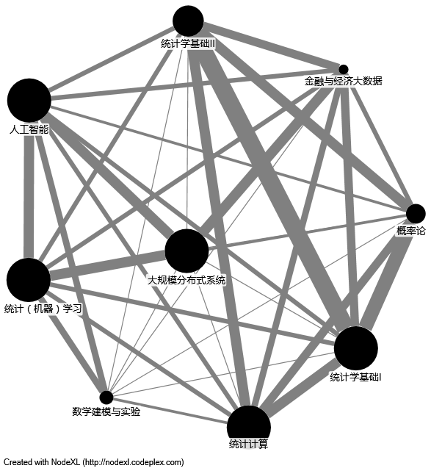
4PART
根据关键词进行文档查询，并展示重要段落。
根据所选领域，对该领域文档关系进行可视化展示。
同义词提取。
对文档的感情色彩进行判断。
(5.)自行爬取/筛选某领域维基百科文档，并对数据进行挖掘。

Slide 23
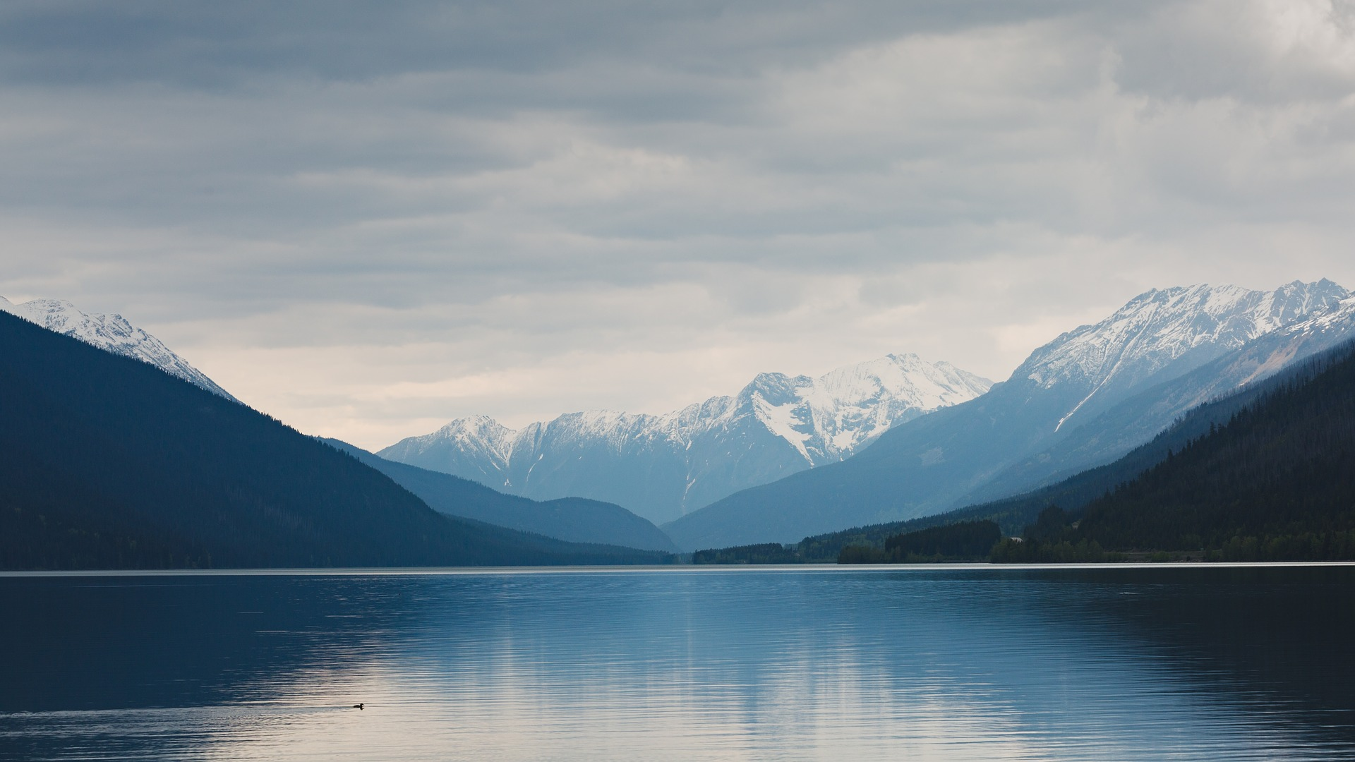
THANKS

